Slide 1


Data Transformation, Analysis, and Insights​
Notes:
Genie

Slide 2



Meet the Team
Genie Carandang
Team Lead
Mahmoud Faisal
Data Engineer
Paul Stephen
Data Viz Developer
Notes:
Genie

Slide 3

Purpose
Equip stakeholders with data-driven Insights & an analytical platform.
Optimize rental car operation
Identify profitable opportunities
Inform strategic investment decisions
Stakeholders Wanted:
Ideal Locations
Favorable Time
Recommended car types/models
Notes:
G: The purpose of our project is to equip our stakeholders, with data-driven insights through an analytical platform. This platform will empower them to optimize their rental car operations, identify profitable opportunities, and inform strategic investment decisions, ultimately maximizing their revenue and growth.
This purpose directly addresses the core questions our stakeholders approached us with were they wanted to know three crucial things.
First, they asked us to scope out potential locations to start a rental car business across the US
Secondly, they wanted to know a favorable time frame to start the business to maximize revenue
And finally, they requested a recommendation on the car types and models best suited for rental fleet

Slide 4
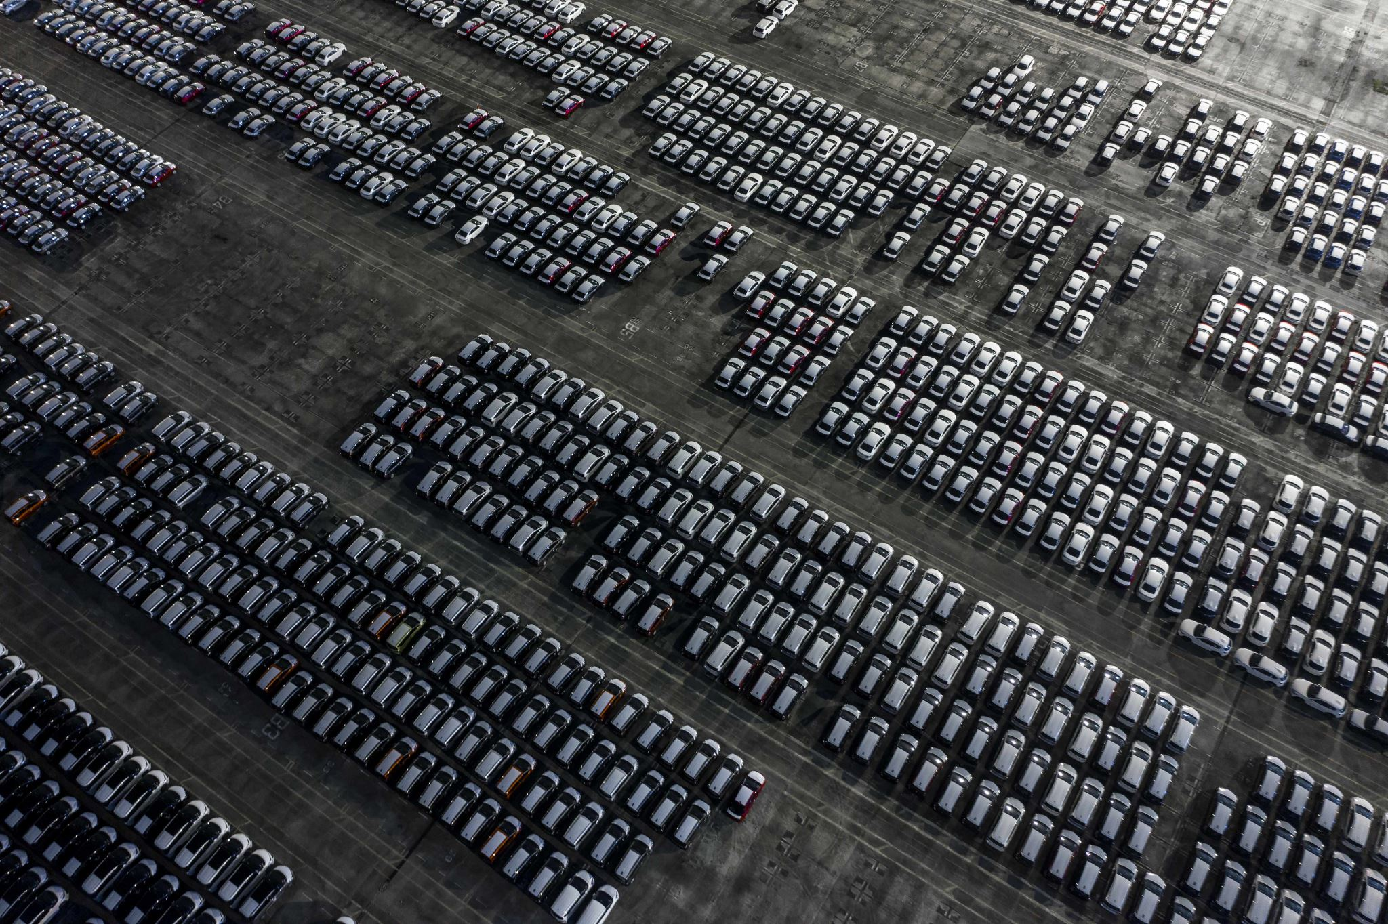



Project Overview
Synopsis:
Our insights will cover:
Rental car market dynamics
Support for informed decision-making in:
Fleet optimization
Operational strategies
Investment
Notes:
P: Our project involves three key phases: first, we will collect data from sources like Turo listings across the U.S. to gather comprehensive rental car data. Secondly, we'll build data warehouse to efficiently store and retrieve all this information. Finally, we'll analyze and visualize that data to understand rental car demand, fleet performance, ROI, utalization trends across different regions and over time. The ultimate goal is to provide actionable insights that reveal the true dynamics of the rental car market, directly assisting our stakeholders in making smarter, data-driven decisions regarding fleet optimization, operational strategies, and future investments

Slide 5
Objectives:
Visualize trends: Rental car demand and fleet utilization at regional level.
Identify key factors influencing rental car performance:
Seasonality
Car Type/Model
Regional Factors
Notes:
P: Moving into our specific objectives, our aim is to visualize trends in rental car demand and fleet utilization, breaking it down by regional levels.
Next, we're focused on identifying the key factors that truly influence rental car performance. This involves digging deep into:
Seasonality: understanding how demand fluctuates throughout the year.
Car Type/Model: determining which specific vehicles perform best.
And finally, Regional Factors: analyzing how local market conditions impact overall performance.

Slide 6







Project Tools
Notes:
P: To successfully execute this project, we've leveraged a lot of useful tools.
For project management and agile tracking, we utilized Jira.
Our core data storage and management is handled by Microsoft SQL Server.
For data analysis and creating interactive dashboards and visualizations, we're using Tableau.
We used Visual Studio to build our analytical model and set up foundational aggregations
And of course, Microsoft Excel and PowerPoint were our go-to for data manipulation and presentation

Slide 7
Requirements Gathering
Identify Key Stakeholders
Define Core Business Objectives
Scope Analytical Focus
Prioritize & Validate Requirements
Notes:
P: We started to gather requirements by identifying stakeholders needs, defining what is business core objectives, and prioritizing and validating requirements.

Slide 8
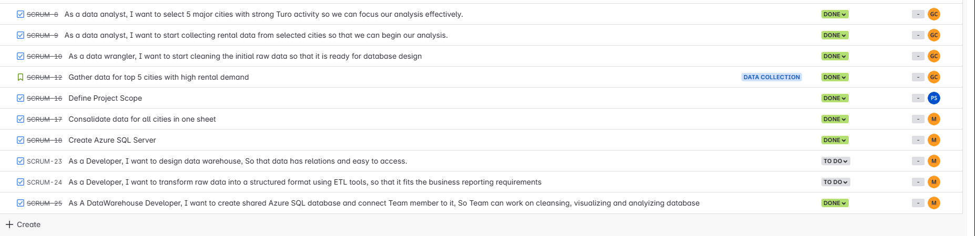
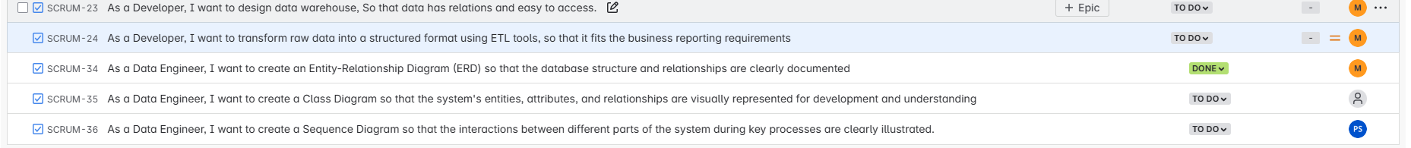
User stories
These User stories were created based on the requirements we gathered

Slide 9





Agile Methodology and Scrum Process
Sprint Planning
Daily Scrums (Stand-ups)
Sprint Execution
Sprint Review & Retrospective
Project Initation and Backlog
Sprint Planning
Daily Scrums (Stand-ups)
Sprint Execution
Sprint Review & Retrospective
Adopting Agile ensures:
Iterative development
Constant collaboration
Delivers continuous value
Notes:
P: To manage this project efficiently and adaptively, we've adopted an Agile Methodology, specifically using the Scrum process. As highlighted, this ensures iterative development, constant collaboration, and a continuous delivery of value.
Our process involves key stages:
We begin with Project Initiation and Backlog to define and prioritize our tasks.
This leads into Sprint Planning, where we decide what to accomplish in each short development cycle.
We then have Daily Scrums, or Stand-ups, for quick team synchronization and progress updates.
The bulk of the work happens during Sprint Execution.
And finally, each sprint concludes with a Sprint Review and Retrospective to assess progress and continuously improve our process

Slide 10
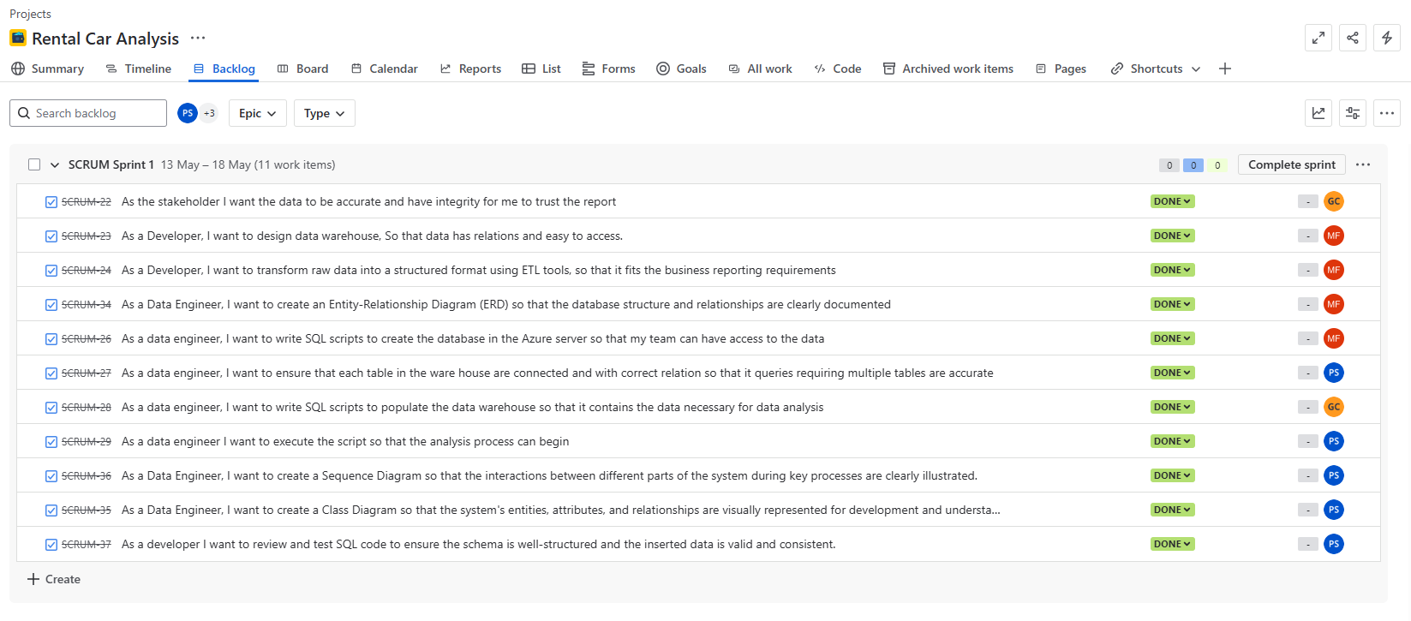
Project Management JIRA
Facilitates Industry Best Practices
Enables Transparent Task & Issue Tracking
Supports Adaptive Planning
Optimizes Project Workflow
Fosters Team Collaboration
Notes:
P: For project management, we rely on Jira. It provides a clear backlog and sprint view of our work
Jira is instrumental because it:
Facilitates Industry Best Practices for project execution.
Enables Transparent Task & Issue Tracking, so everyone knows the project status.
Supports Adaptive Planning, allowing us to respond quickly to changes.
Optimizes our Project Workflow, streamlining our processes.
And significantly Fosters Team Collaboration, keeping everyone aligned and engaged

Slide 11
Sprint Schedule
Sprint 0
Sprint 1
Sprint 2
Sprint 3
April 21- May 4th
May 5th – May 18th
May 19th – June 1
June 2nd – June 9th
Each sprint concludes with:
a detailed report featuring analytical diagrams
new data visualizations
meeting summaries.
Notes:
P: This is our Sprint Schedule, outlining the different phases of our project.
We kicked off with Sprint 0 from April 21st to May 4th. Followed by Sprint 1 from May 5th to May 18th. Sprint 2 went from May 19th to June 1st. And we concluded with Sprint 3, which went from June 2nd to June 9th.
Crucially, each sprint concludes with a detailed report, featuring analytical diagrams, new data visualizations, and comprehensive meeting summaries.

Slide 12
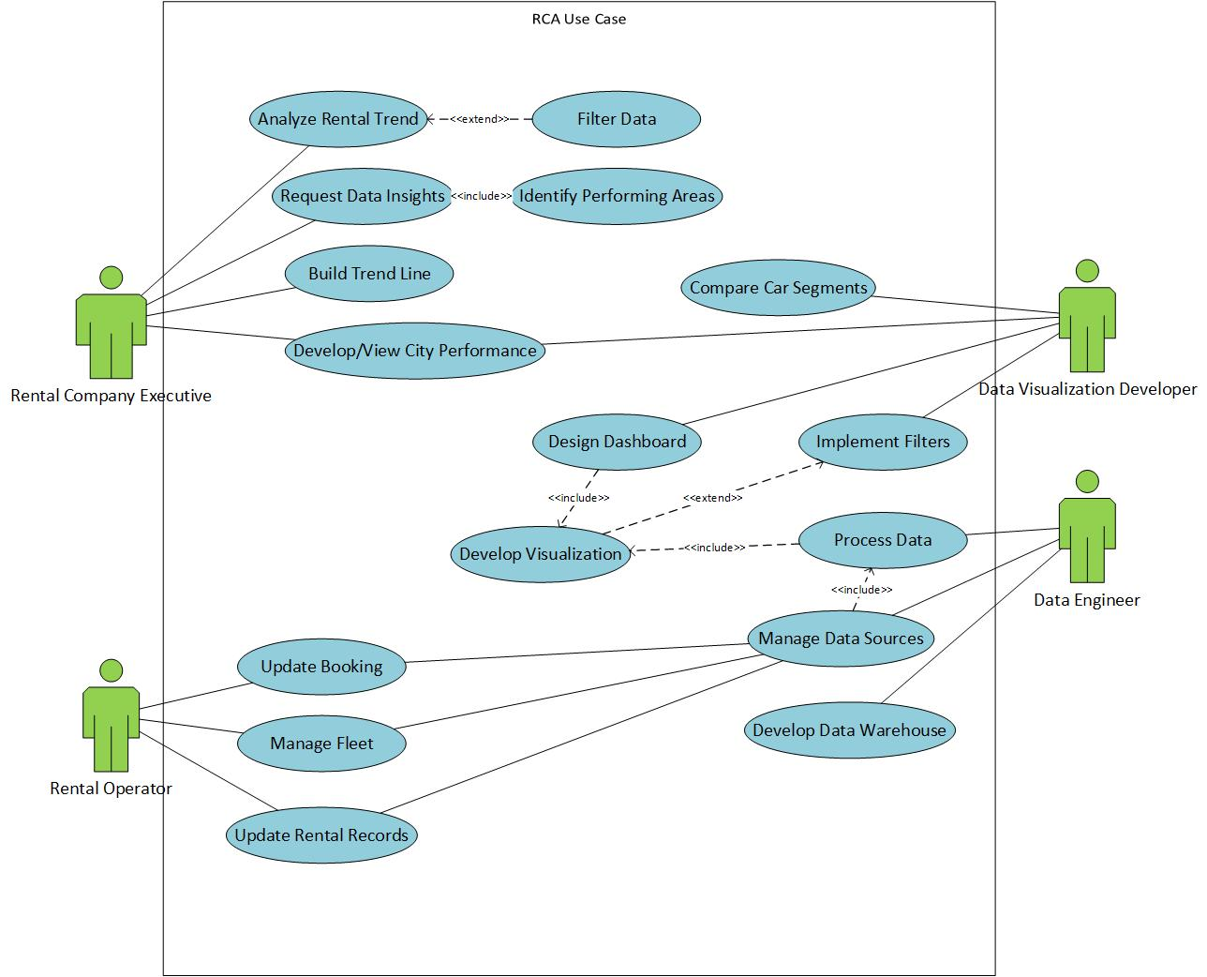
Design Document: Use case
Notes:
M: Thank you Paul,here is Use case diagram which has 4 actors (Rental car Executives, Data visualization developer, Data engineer, and Rental operator). Rental car Executives request insights and analyze trends to help them make decisions. The Data Engineer creates a data warehouse and helps the data visualization developer design the dashboard. The rental operator is updating current bookings and managing the fleet. Next silde please

Slide 13
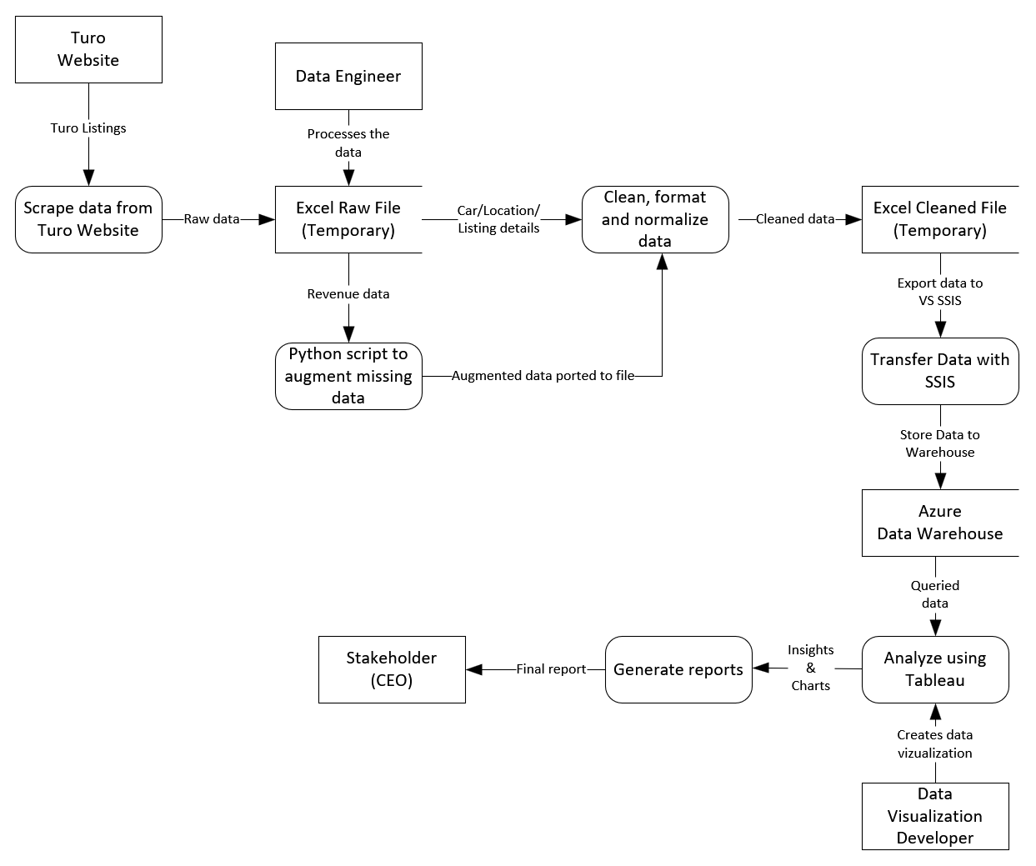
Design Document: Data Flow
Notes:
M – Here is our data flow diagram which shows how data moves throughout our project.
The source of our data is the Turo website itself by scraping data then we used MS SQL server integration services to import data from Excel to SQL server. Then we used Tableau to generate reports. Next slide please

Slide 14
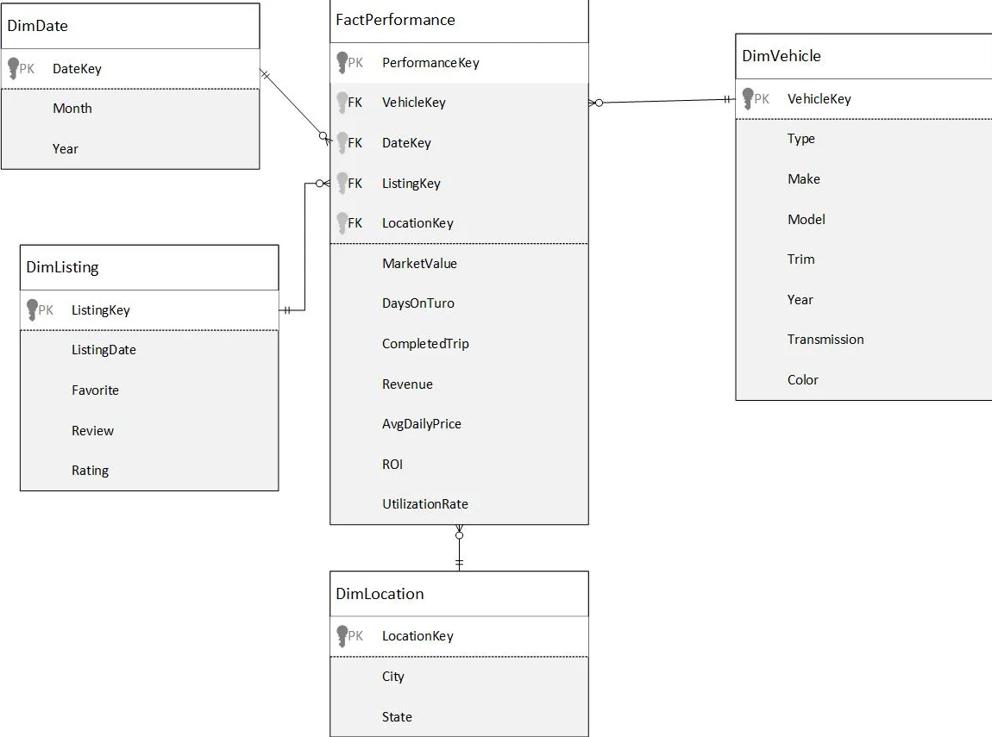
Design Document: OLAP UML Diagram
Notes:
M: OLAP diagram represents star schema to design warehouse. We created a fact table (the main Table)and connected it with 4-dimensional tables (DimDate, DimVehicle, Dimlisting, and DimLocation) by using one-to-many relationships – Next, please.

Slide 15
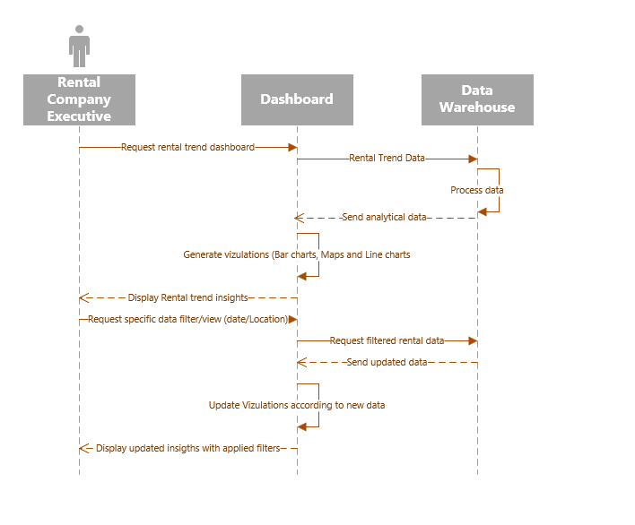
Design Document: Sequence Diagram 1
Notes:
M: Here is an example of a sequence diagram showing interactions between a Rental Company Executive and Data Warehouse. The Executive initiates requests for dashboards, prompting data retrieval and processing from the Data Warehouse, which returns analytical data for visualization. the Executive can refine insights by requesting specific filters and insights displayed through the dashboard interface. Here is Genie

Slide 16
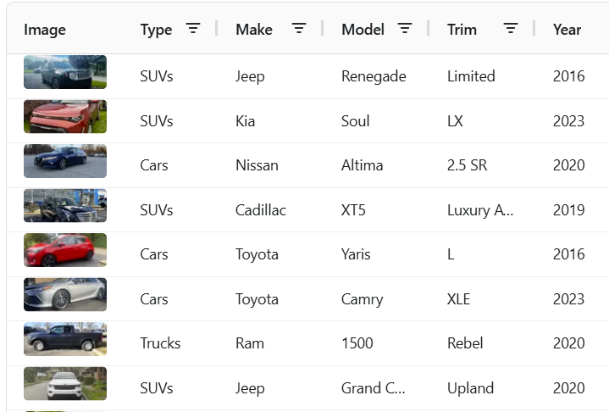
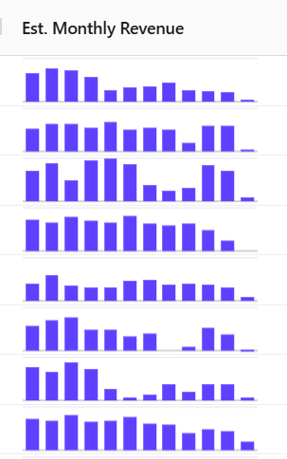
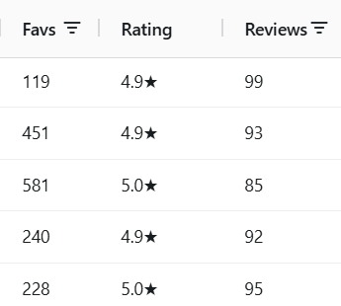
Data Collection
Notes:
G – Here is what the data collections process looks like.
Data is scraped from the Turo website itself so it is real authentic data.
First we scraped data from 10 large cities but then the scope of the project grew to include all of Main land US
The data we collected includes: exact model of the vehicle, monthly revenue data the past year, listing information (review, # of trips) and many more

Slide 17
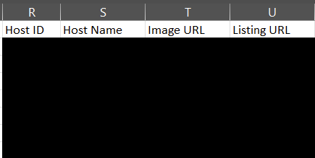
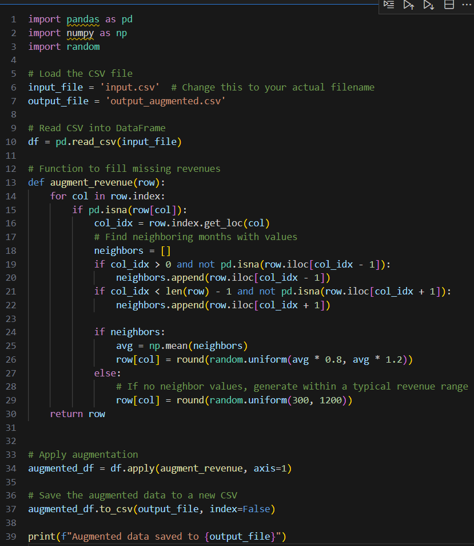
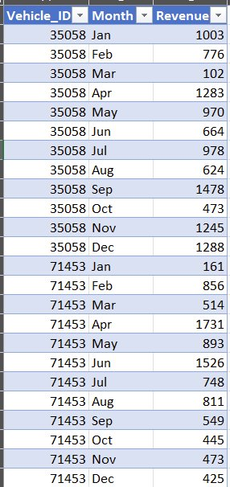
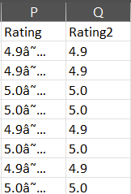
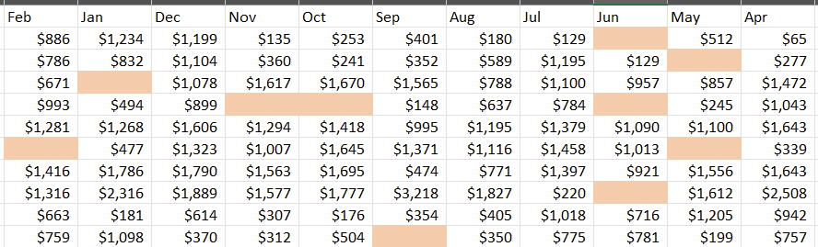
Data Cleaning
Notes:
G – After scraping over 20000 listings, it is exported to excel in batches
We needed to redact information such as host names and website links
Formatting error and missing values in the revenue data which was crucial
A python script was used to generate missing values

Slide 18
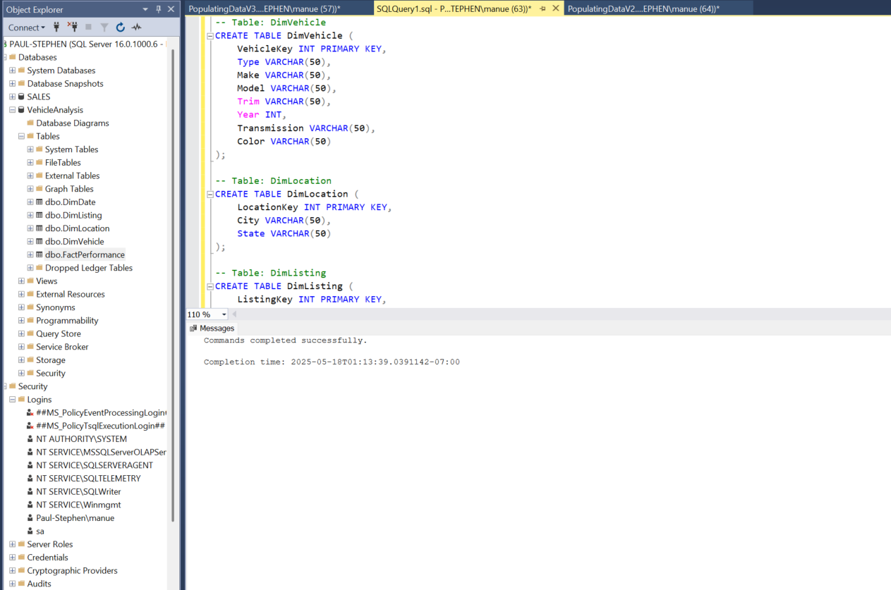
SQL Script - Create Tables
Notes:
G – Here is the SQL script which creates the tables in our Data warehouse.

Slide 19
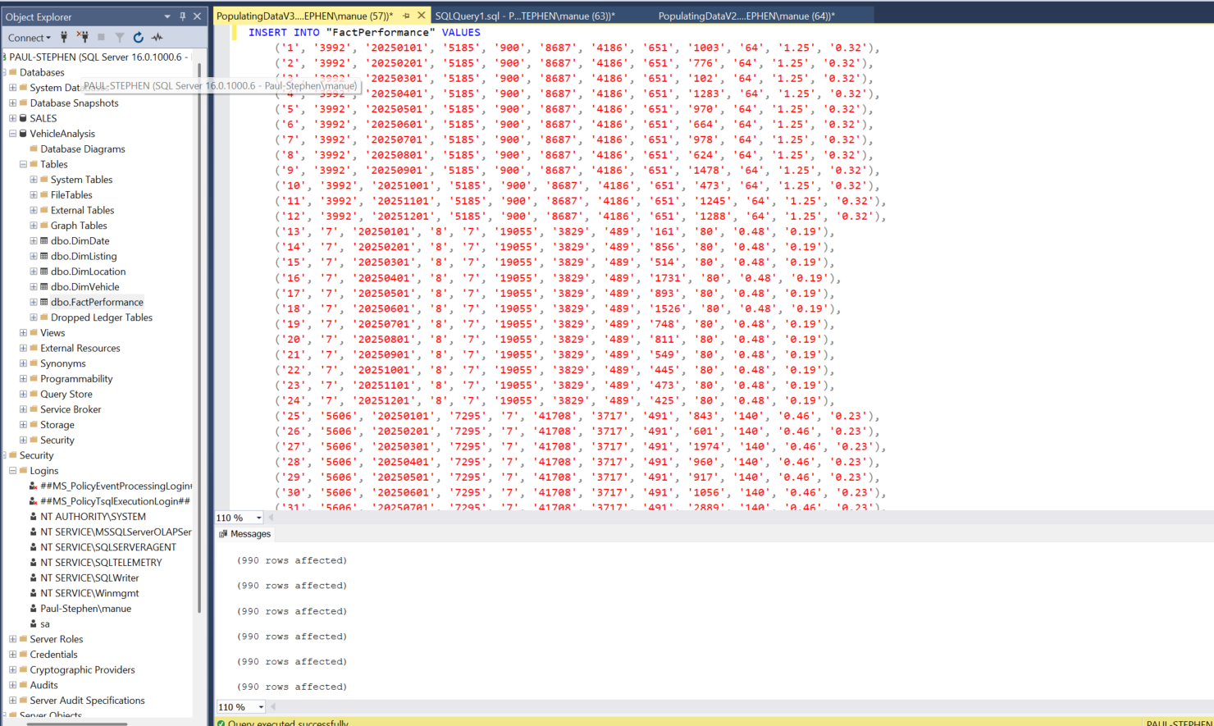
SQL Script - Upload Data
Notes:
G – Here is the script for populating out data warehouse

Slide 20
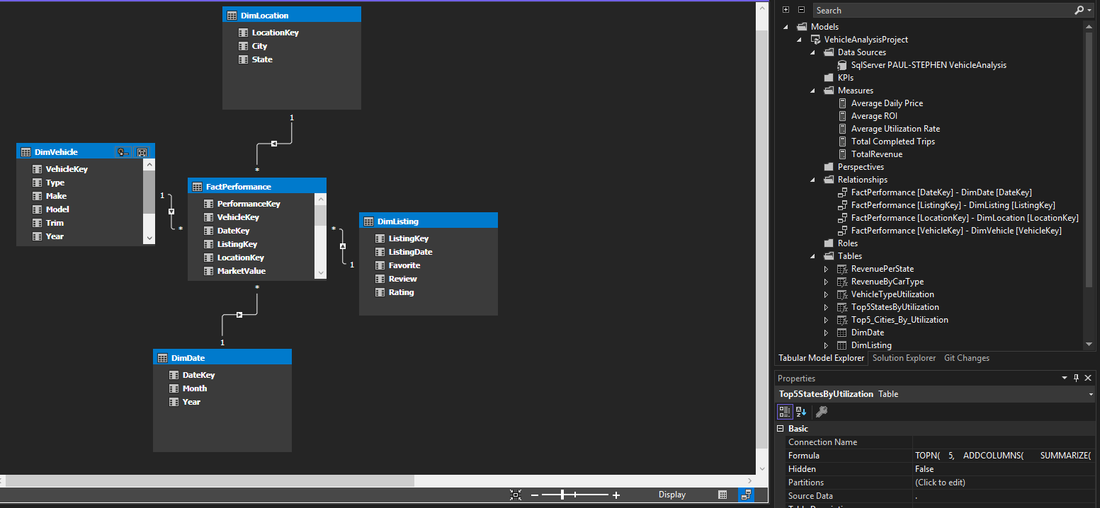
SSAS Table Relationship - P
Notes:
P: This demonstrates the table relationships within our data model, specifically how we've structured it for analytics.
After extracting and transforming our data, we imported it into SQL Server Analysis Services (SSAS). This allows us to build powerful, performant analytical models.
As you can see, the relationships between our dimension tables and the central FactPerformance table are clearly defined, ensuring the integrity and efficiency needed for our reporting and insights generation

Slide 21
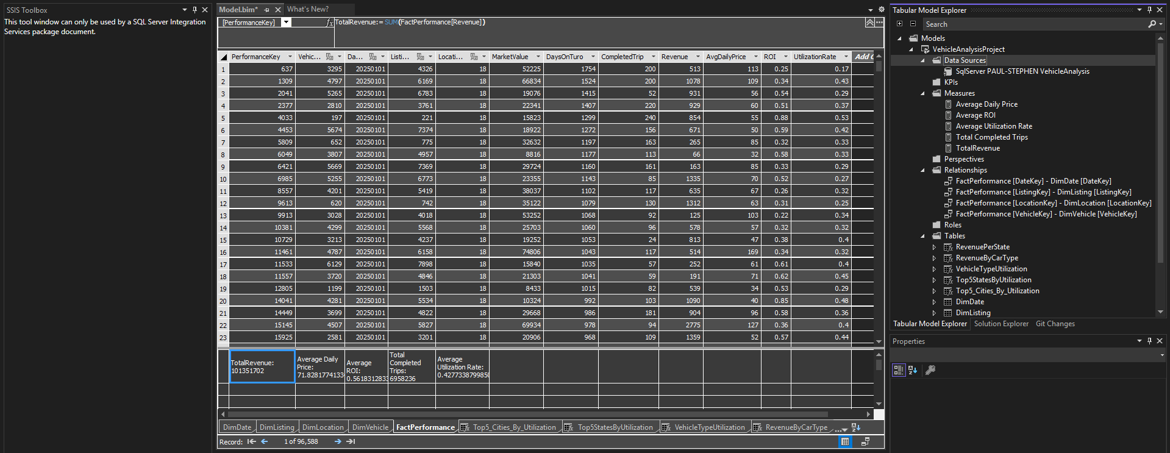
SSIS DATA - P
Notes:
P: This slide shows a glimpse of our FactPerformance table within our analytical model, populated with actual data.
From this raw data, we've performed basic aggregations to derive key performance indicators, such as Total Revenue and Average Utilization Rate

Slide 22
Tableau Analysis Questions
Questions:
1. Where is the best place to open a rental car company?
2. When should the business open?
3. What cars are most suitable for rental?
Notes:
G – Here are the business questions we will be answering with the use of Tableau

Slide 23
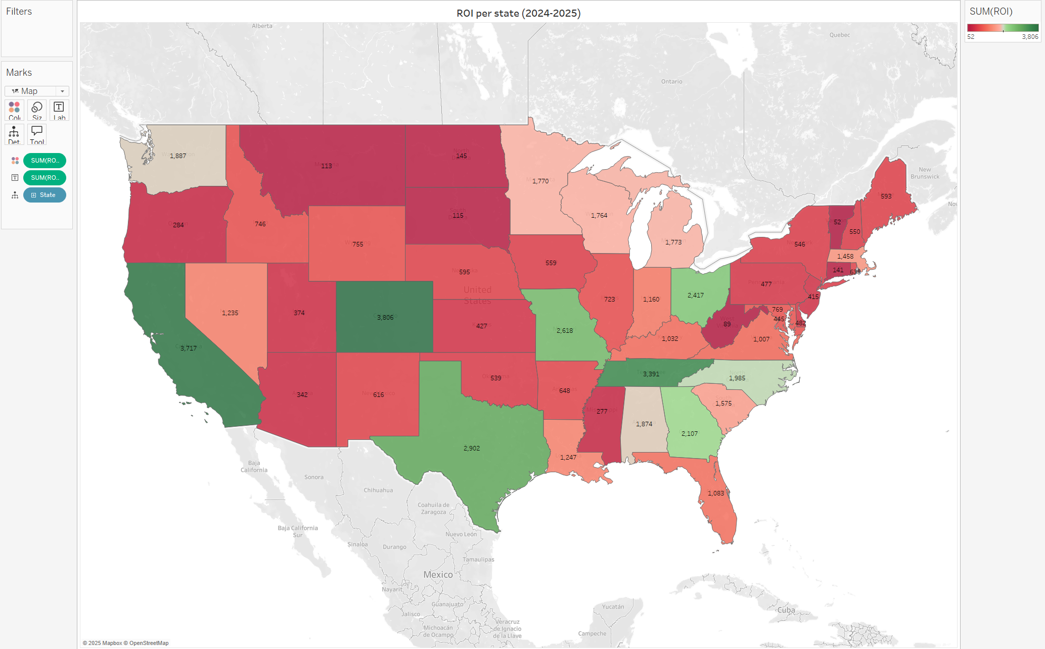
Tableau
Notes:
M: Moving onto our first visualization, This is a map showing projected ROI per state for 2024 -2025.
The color coding highlights areas of higher potential. States in greener shades indicate a stronger ROI, while red areas show lower potential.
This visualization directly addresses our stakeholders' need to scope potential locations, allowing them to visually identify the most promising geographic areas for new rental car business. As you see California, Colorado, Tennessee, Texas would be ideal locations to start a rental car business. Next

Slide 24
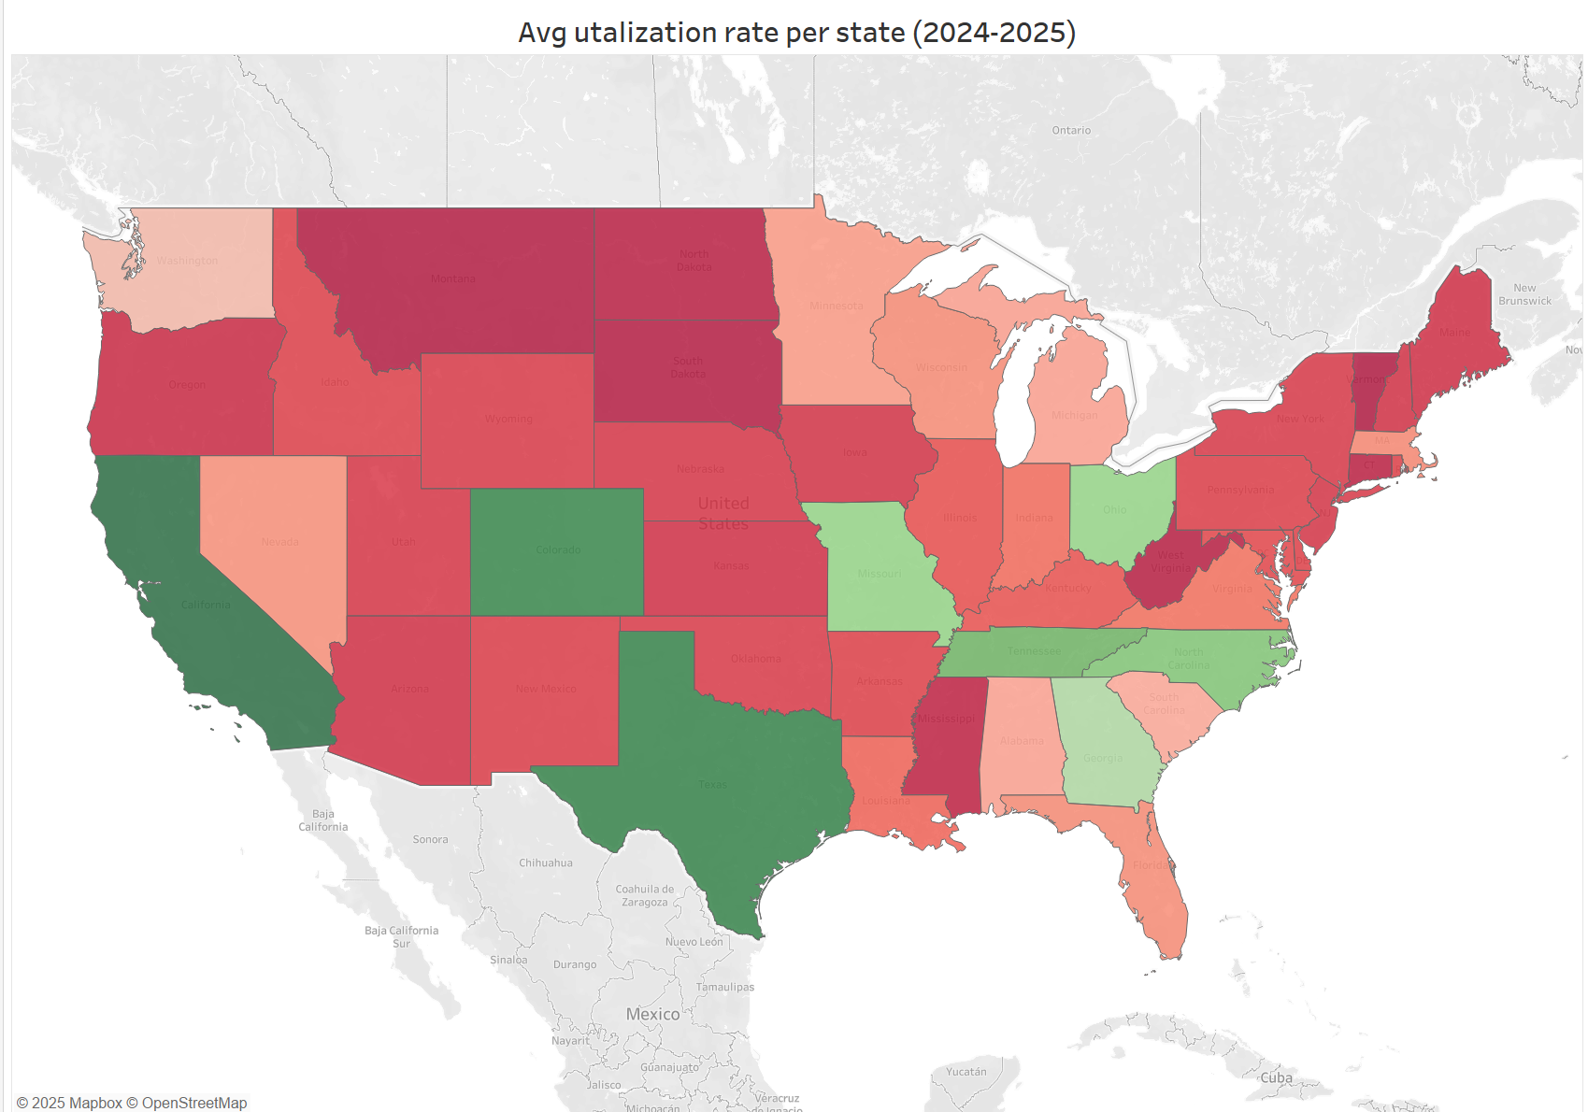
Tableau
Notes:
M: This map illustrates the Average Utilization Rate per state for 2024-2025.
The green states indicate areas where we project higher fleet utilization, meaning cars are rented out more frequently. while, red states suggest lower utilization rates.
High utilization means maximizing fleet ROI, directly impacting on profitability when considering new locations Next

Slide 25
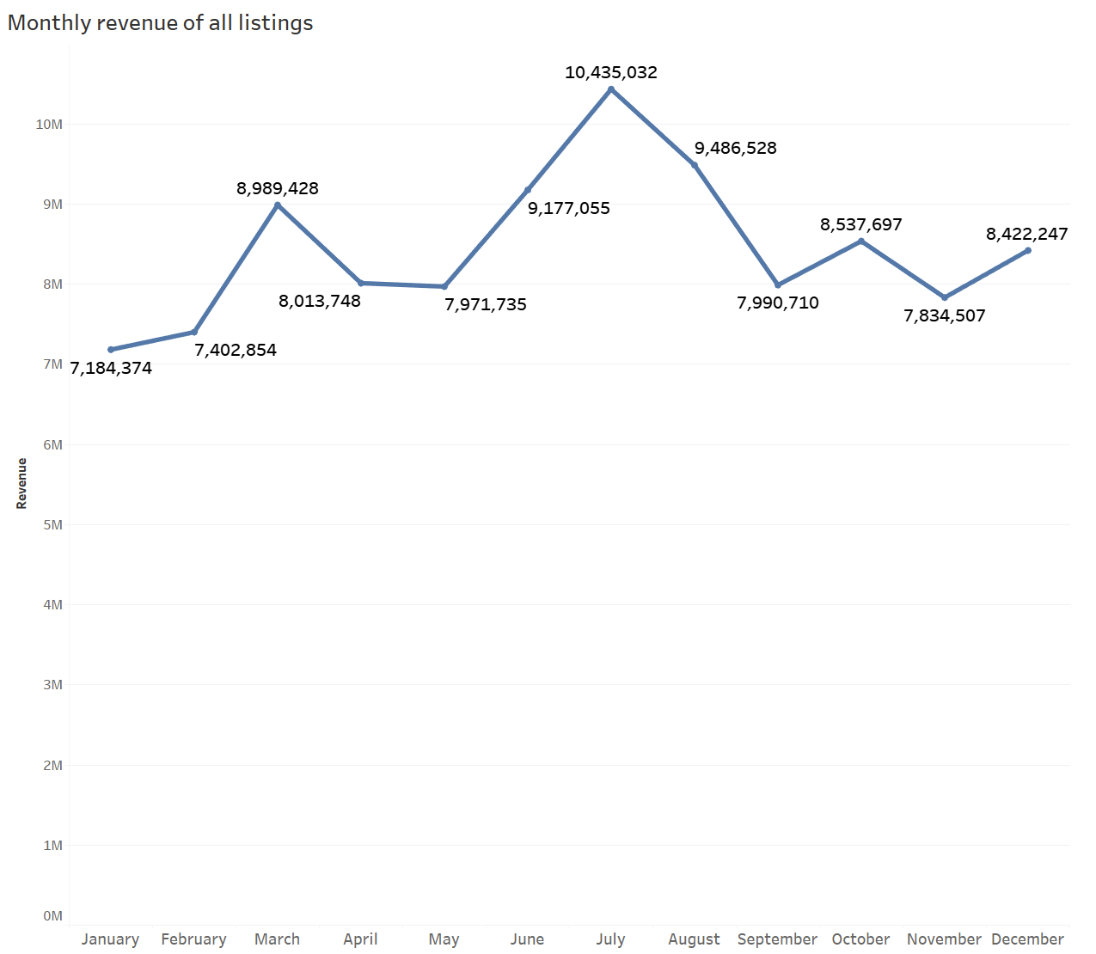
Tableau
Notes:
M – Here we see the monthly revenue trends. It shows that revenues spike in March because of spring break. Starting from may is the best time to open a business, with the highest revenues, which might be because of the summer vacation. Next please

Slide 26
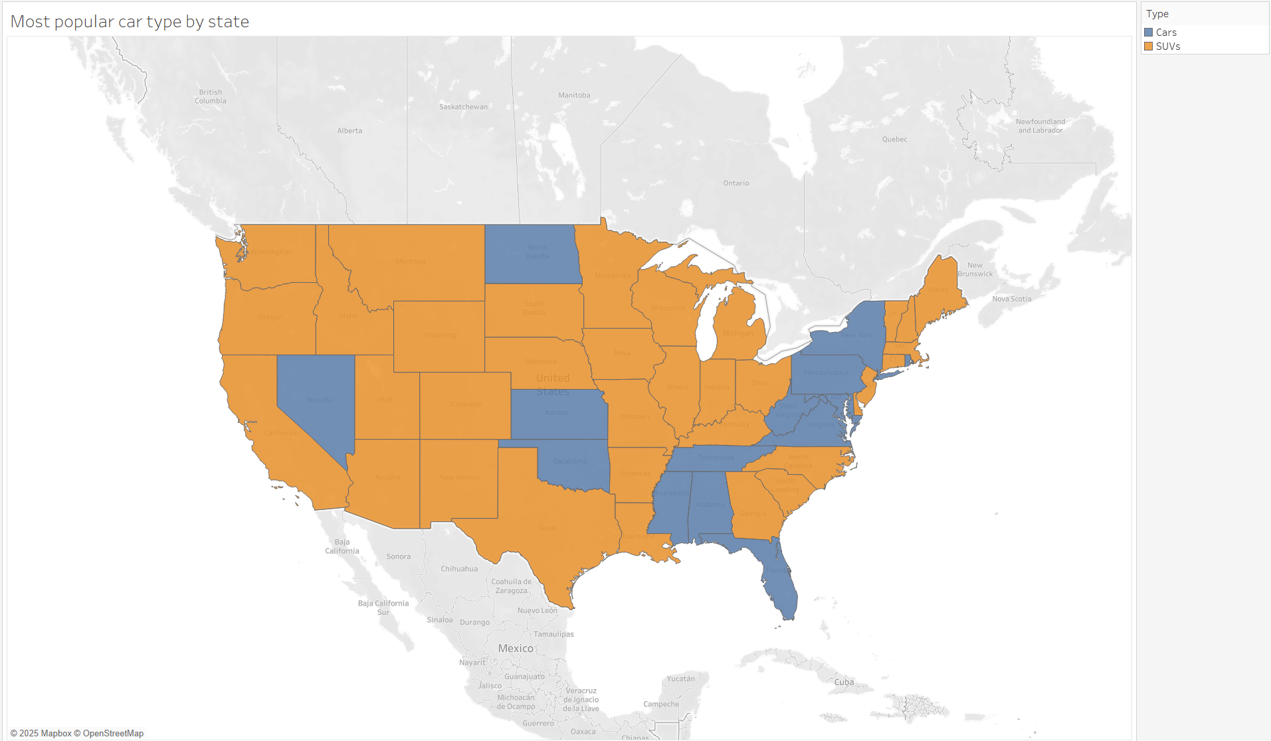
Tableau
Notes:
M – This chart shows the most popular car type to rent .It shows that SUV dominate the west side of the Mississippi While Cars shows an equal competition in the east coast
This tells us that SUVs are the way to go but Cars in the east is still a valid option - Genie

Slide 27
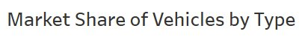
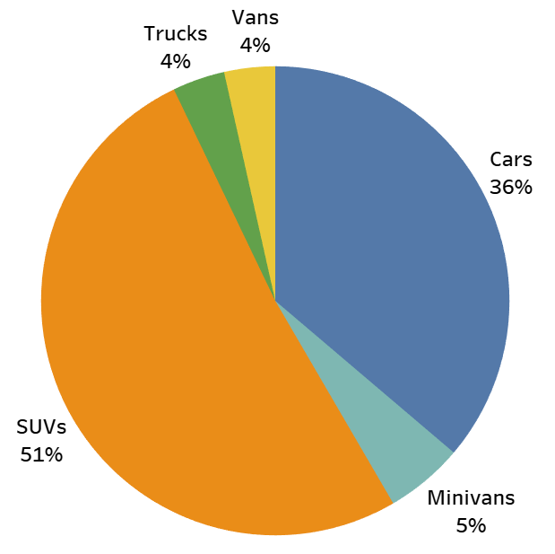
Vehicle Type Analysis
SUVs control half of the car rental space due to:
High usage/utilization
High count
General practicality
Notes:
G
Here is a pie chart which shows the whole car rental market divided by car type
As we can see, it is largely dominated by SUVs controlling over 50% of the market.
This tells us that our fleet of vehicles should be comprised of SUVs

Slide 28
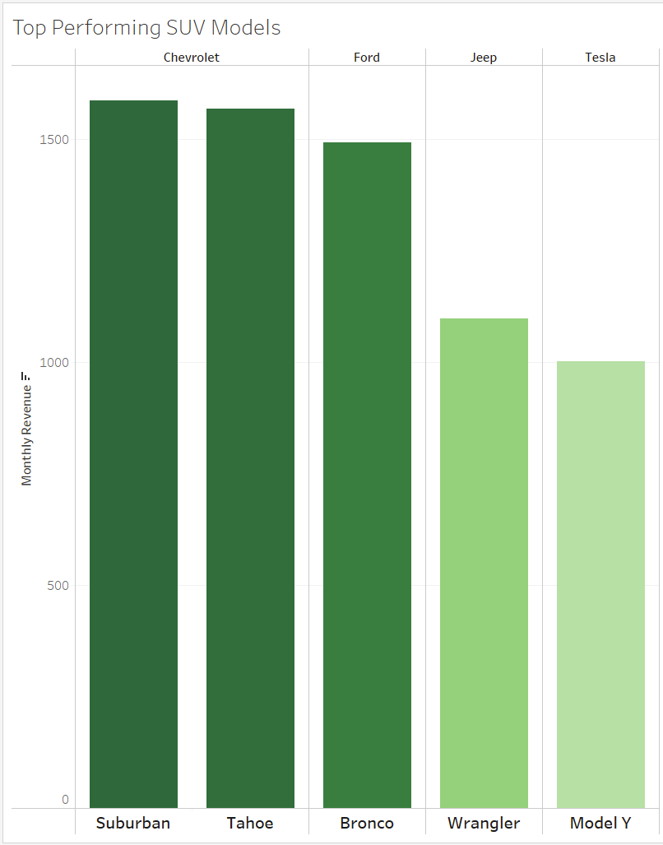
SUV model Analysis
The top 5 performing SUV models are:
Chevy Suburban
Chevy Tahoe
Ford Bronco
Jeep Wrangler
Tesla Model Y
Notes:
G – This chart shows the trend line of cars and SUV
The Y axis represent the vehicle price and the X axis represents the average monthly revenue
This chart tells us when buying a vehicles over 25k, SUV on average will perform better than cars and vehicles under 25k, cars will generally outperform SUVs.

Slide 29
Blueprint for a Successful Rental Car Venture
1. Where is the best place to open a rental car company?
Based on our analysis, ideal locations include California, Colorado, Tennessee, and Texas
2. When should the business open?
June and July would be ideal months to open the business.
3. What cars are most suitable for rental?
Chevy Tahoe and Suburban are the top performing SUVs
Notes:
G – Some of the best areas to start a Turo business are in California, Colorado, Texas and Tennessee
The best time to start the business is at the start of summer where the rental market as a whole start to ramp up.
The rental car market is largely dominated by SUVs controlling half of the car rental market. Cannot go wrong with using a fleet of SUVs
If you want to dive in the lower end of the market, Cars are the way to go especially in the east coast, It is more popular there

Slide 30
Reflection
What did we do well?
Identified ideal locations (CA, CO, TN, TX) for rental car business.
Determined optimal timing (June/July) for launch.
Analyzed the revenue performance of diverse vehicle models (e.g., sedans, SUVs, minivans, vans) to determine fleet suitability
Successfully utilized Agile Scrum methodology for efficient project management.
Maintained strong team collaboration throughout the project.
What did not go well?
Finding the right data set for the project
Project benefits
Provides actionable insights for strategic rental car business planning.
Offers a foundation for future market expansion analysis.
Enables data-driven decision-making for fleet optimization and timing
How can we improve?
Integrate cost analysis (e.g., maintenance, insurance) for car suitability
Acquire more detailed, real-time market data (e.g., local demand, competitor pricing)
Notes:
P:
What did we do well:
We were able to answer all of our business questions to a satisfactory degree .
We successfully utilized agile scrum methodology for efficient project management
And we maintained strong team collaboration through out the project
What did not go well?:
We initially struggled to find the right data set to answer our business questions. We went over several data set found online and they all did not meet our standard
We had to resort to scraping the data ourselves from the source to answer the business question. Which took a significant portion of sprint 1's time
In terms of the project benefits. We were able to provide actionable insights for strategic rental car business planning. This offers a foundation for future market expansion analysis. And It Enables data-driven decision-making for fleet optimization and timing.
How can we improve?
An area for improvement is again the data, We want to integrate cost analysis like maintenance cost and insurance for car suitability
And a more detailed data which also covers other websites or local demand

Slide 31
Thank You
Notes:
G

Slide 32
Questions & Answers
Invite feedback and questions from stakeholders.
Notes:
G

